Slide 1


VOICE
&
ACCENT

Slide 2


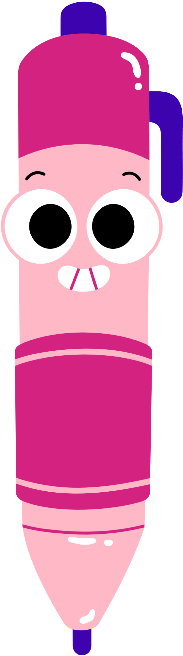




MANNER OF
ARTICULATION

Slide 3
INTRODUCTION
Manner of Articulation is the “how” of making sounds .
It refers to the way the vocal tract is configured to shape the airflow during speech production.
Understanding the various manners of articulation is crucial for linguists, speech therapists, and language learners alike, as it provides insight into the intricate mechanics of human speech.

Slide 4
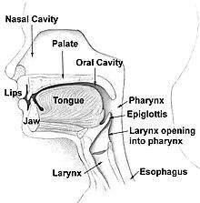
THERE ARE SIX MANNERS OF ARTICULATION

Slide 5

NASAL
Nasal consonants are created when you completely block air flow through your mouth and let the air pass through your nose.
There are three nasal consonants in English.

Slide 6
EXAMPLES
/m/: Mat, mother, mum
/n/: Nap, naughty
/ŋ/: Nothing, something, king, ring

Slide 7

PLOSIVES
Plosives/Stop consonants occur when the vocal tract is closed completely. But for stops the airflow is NOT redirected through the nose.
Instead, the air quickly builds up pressure behind the articulators and then releases in a burst.

Slide 8
EXAMPLE
/p/: Pot, Peter, Department, Perfect
/t/: Talk, Time, Distinct, Turn
/k/: Kitten, Cot, Hacker, Calling, Honk
/b/: Baker, Boston, Tub, bark, Basket
/d/: Develop, Pardon, Discover, Demolish
/g/: Glorified, Gaggle, Mug, Garments

Slide 9
FRICATIVES
fricative sounds involve only a partial blockage of the vocal tract so that air has to be forced through a narrow channel.
For example, you create a /t/ stop consonant when you block airflow completely with your tongue against the alveolar ridge. But if you let up with the tongue a bit and let the air seep through, you make an /s/ fricative consonant.

Slide 10
EXAMPLES
/f/: Graph, Cough, Fan, Leaf
/v/: Dove, Victor, Divine
/θ/: thin, thought, bath, anything
/ð/: the, father mother
/ʃ/: sugar shrimp, shove hush
/ʒ/: pleasure measure, treasure
/h/ hungry hot
/s/ some, Susie ,sorted
/z/: please, zip, scissors

Slide 11
IDENTIFY THE MANNER OF ARTICULATION
Man kite
Summer Cab
Moon bus
Tab Thick
Vine
Funk mad

Slide 12
AFFRICATES
When stop consonants mix with fricative consonants, the result is an affricate consonant.
Affricate consonants start as stop sounds with air building up behind an articulator which then releases through a narrow channel as a fricative (instead of a clean burst as stops do).

Slide 13
EXAMPLE
/t ʃ /: Church, chip, chuck, chair
/ d ʒ /: John, jump, jungle, jockey

Slide 14
APPROXIMANT
Approximants are when two articulators come close together but not quite close enough to create air turbulence.
The resulting sound is more like a fast vowel than anything else.
For example, the /w/ approximant is like a fast /u/ sound (say /u/ + /aɪ/ really fast and you get the word “why”). Notice how your tongue never actually comes in contact with the top of your mouth.

Slide 15
EXAMPLES
/w/ – “wet” and “Howard”
/j/ – “yes” and “bayou”
/ɹ/ – “right” and “roar”

Slide 16
LATERAL
Lateral consonants are when the tongue blocks the middle of your mouth so that air has to pass around the sides.

Slide 17
EXAMPLE
There is one lateral consonant in English:
/l/ – “luck”
place the tip of the tongue at the alveolar ridge

Slide 18
IDENTIFY THE MANNER OF ARTICULATION
jam right
roar wet
yes match
chick laugh
let badge

Slide 19

THANK YOU

